Slide 1
Association Class

Slide 2
Links Between Objects
In many cases information associated with the links between objects needs to be maintained.
*
credits
*
Student
Course
Example:
  A student takes a course and gets a grade for it.
  The grade only makes sense if we know the student and the course. Also the semester to be remembered.
  The obtained grade is not an attribute of either class.

Slide 3
Association Class
Sometimes an association relation needs to have its own attributes and methods:
  Example 1: A teacher teaches a subject:
    A teacher may teach the same subject multiple times over many semesters
    Each time the students may be different
  Example 2: A person works for a company
    The date he joined a company
    Pay scale and grade at which joined, and so on
    A person may join a company multiple times
teaches
Teacher
Subject
Teacher
Subject
Taught
Person
Company
Employment

Slide 4
Association Class
An association class is shown as a class symbol:
  Attached to the association symbol by a dashed line.
An association class:
  Same name as the association relation because...
  It represents the association!
Course
*
Student
Registration

Slide 5
Association Class
*
credit
*
Student
Course
Student
*
*
Course
Credit

Slide 6
Association Class: Example 1
Server
1
Connection
Client
*
Connection
baudRate
protocol
total Cost
Disconnect
reportUsage
rerouteLink
• These attributes don’t belong
to either the Client or Server
class.
• They are attributes of the
connection itself.
• An association class can have methods as well as attributes.

Slide 7
Association Class: Example 2
12
5
Person
*
Skill
*
How many association class objects?
Competency
An association class is a “normal” class, and may include attributes, methods, relations, inheritance etc.
For every person-skill link, there a competency object…
-level
-date acquired

Slide 8
Implementing Association Class
Module
*
Student
Module
Student
1
Registration
*
Registration
Class Diagram
Mark: Integer
Mark: Integer
Class Diagram
:Module
:Student
:Module
:Student
:Registration
:Registration
Mark = 76
Mark = 76
:Student
:Student
:Registration
:Registration
Object Diagram
Mark = 89
Object Diagram
Mark = 89

Slide 9
Reification
Student
*
*
Course
Credit
Student
*
Credit
*
Course
Reification means “Replacing an association class with a normal Class”.
Dictionary: Reification is when you treat something abstract as a physical thing.

Slide 10
Association Class: Java Code
Pass the Student to Registration.
public class Module {
private Vector <Registration> reg=new Vector<Registration>();
public void enrol(Student st) {
reg.addElement( new Registration(st) );
}
...
}
Maintain the link to Registration
class Registration {
private Student student;
private int mark;
Registration(Student st) {
student = st; mark = 0;
}
...
}
Module
Student
1
*
Registration
Mark: Integer
Keep track of the Student reference.

Slide 11
Association Class: Example 3
RealEstate
Developer
1
*
Client
Contract
An association class is a “normal” class, and may include relations, inheritance etc.
Amount
Contract #
Date

Slide 12


Slide 13
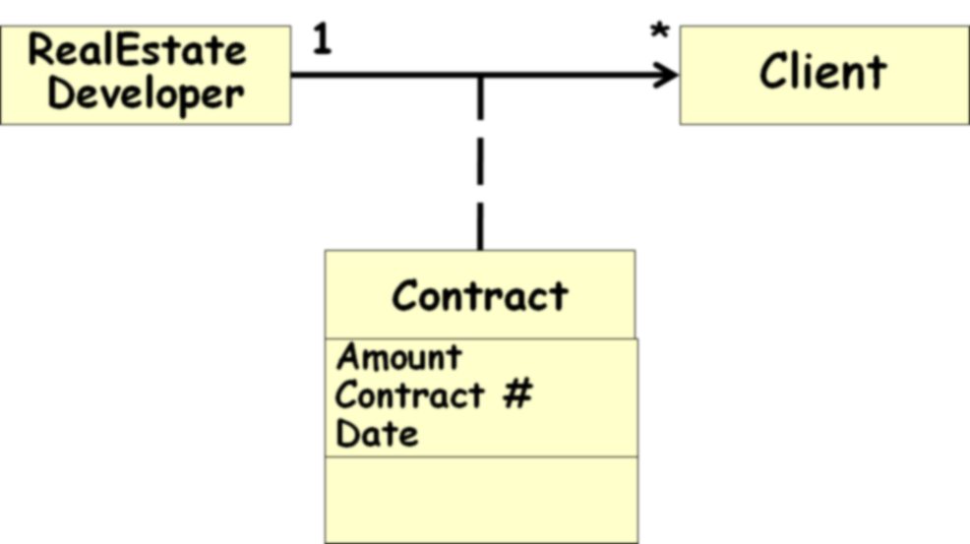
public class RealEstateDeveloper{
private Vector <Contract> contracts= new Vector <Contract>();
public void buy(Client c){contracts.add(new Contract(c))};
}
public class Client{
private Address address;
public Address getCurrentAddress(){}
}
public class Contract{
private Client client;
private int contractNo;
public Contract(Client c){ client=c;}
}
RealEstDev
Client
1
*
Contract
ConNo: Integer

Slide 14
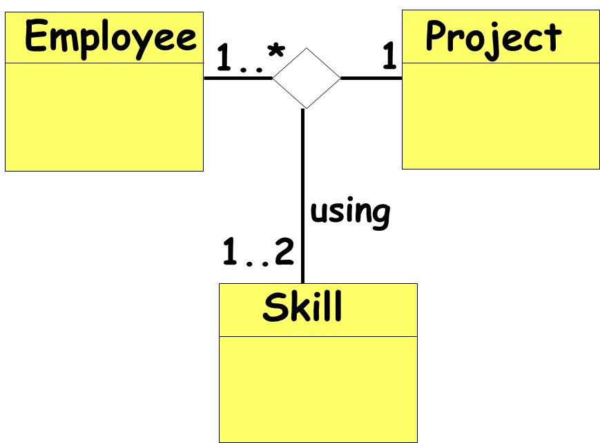
Ternary Association
Some times three (or more) classes may be associated.
An object of an association class:
  Stores the details for the two associated classes.

Slide 15
Ternary Association
Man
Woman
1
1
marry
1..3
Priest
and we can add more classes to the diamond…

Slide 16
Implementation of Ternary Association
There are several ways in which ternary association can be implemented.
  One is to decompose it into a set of binary associations.
Man
Marriage
Woman
1
1
1
1
Participates in
Participates in
*
Performed by
1..3
Priest

Slide 17
Record
Info
Goals
Player
Team
11
1
As association arity increases, implementation complexity increases… We shall exclude from our discussions 3ary and higher-ary associations…
*
Season

Slide 18
Association Quiz
Book
Editor
title: String
*
1
name: String
Edited by
editor: String
myBooks: Book
What is wrong?
Association denoted by symbol not attributes.
  Implementation (pointers, arrays, vectors, ids etc) is left to the detailed design phase.
Wrong arrow type

Slide 19
Qualified Association

Slide 20
Qualified Association
A qualified association allows us to restrict the number of objects referred in an association and express uniqueness
Implemented by hash tables, maps, dictionaries.
How to read?
There exists upto one file for each instance of filename in the directory .
Class
Student
belongs
*
1
Class
0..1
Student
Roll
Read
1
Directory
file name
0..1
File

Slide 21
An Example
An order has of many Order lines.
There is at most one Order Line in the Order for each instance of Product.
Order
1
*
Order Line
Has Line item
1
Order
0..1
Order Line
Product
Line item

Slide 22
Qualified Association…
League
1
*
Player
nickName
1
0..1
League
nickName
Player
The second conveys more information…
Hints on implementation…
Effectively reduces multiplicity…

Slide 23
Qualified Association: Implementation
1
0..1
League
nickName
Player
public class Player {
private League
league;
}
public class League {
private Map players=new HashMap;
public void addPlayer
(String nickName, Player p) {
if(!players.containsKey(nickName))
players.put(nickName, p);
}
}

Slide 24
Converting to Qualified Association
Role
Person
Company
employee
employer
*
works for
1
Association Name
Assume company assigns each employee a unique empId.
Give qualified association representation…
Person
employer
Company
employee
works for
empId
0..1
1

Slide 25
Qualified Association
1
Bank
0..1
Account
accno
Qualifier hints at setting up efficient access to linked objects:
  For example, access accounts based only on the account number;
  Also to avoid a linear search through all accounts.

Slide 26


Slide 27
Types of Class Relationships
Relation
Generalization
Association
Dependency
Binary Association
N-ary Association
Aggregation
Composition

Slide 28
Overdoing Associations
Avoid unnecessary Associations
PersonInfo
Address
E-Mail
Birthday
PersonInfo
Name
Address
E-Mail
Birthday
Person
Name
1
1
Avoid This…
Do This

Slide 29
“Or” Association
Used when all association combinations in a class model are not valid.
Example:
  A person can have an insurance contract with an insurance company
  Also a company can have an insurance contract with an insurance company
  A person and a company CANNOT have the same insurance contract with an insurance company.
Skip

Slide 30
“Or” Association Example
Skip
1
Insurance Company
*
Insurance Contract
*
*
{or}
1..*
1..*
Person
Company

Slide 31
Summary of Implementation of Association
1-to-1 association:
  Role names become attributes
1-to-many association:
  Translate into a Vector or ArrayList
Qualified association:
  Translate into a Map or Hash table
Notes:
Not covered in Fall 91 class

Slide 32
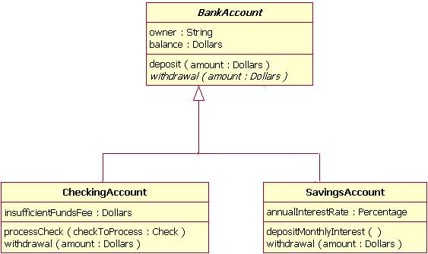
Which sentences are true?
a) CheckingAccount implements BankAccount
b) CheckingAccount and SavingAccount are BankAccount
c) CheckingAccount and SavingAccount are associated
d) BankAccount is associated to CheckingAccount
e) SavingAccount can processCheck
f) CheckingAccount has a balance

